Slide 1
NARX MODEL DEVELOPMENT FOR MRE STUDY
Sooraj Poojary

Slide 2
Introduction
The NARX model is a type of nonlinear dynamic model used for time-series prediction and system identification.
It extends the traditional AutoRegressive with eXogenous inputs (ARX) model by introducing nonlinear elements.

Slide 3
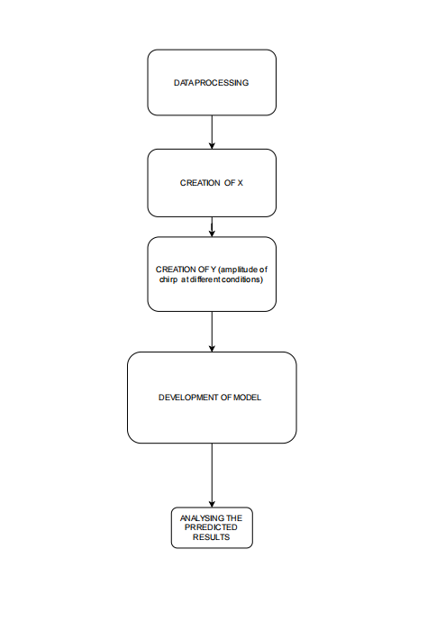
METHODOLOGY

Slide 4
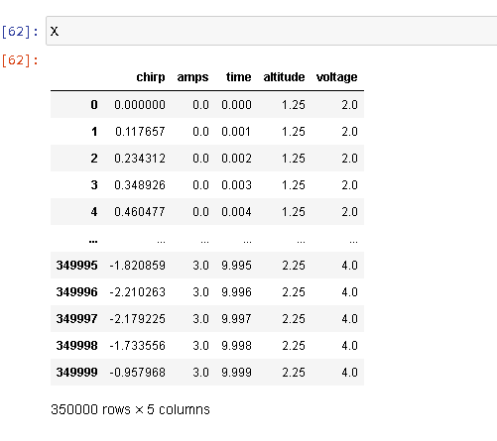
X values

Slide 5
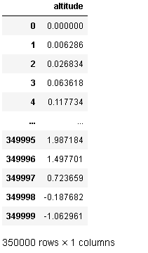
Y values

Slide 6
MODEL
Learning rate : 0.001
Optimiser : Adam
5 input neurons , 128 (hidden) neurons at the middle and finally 1 output neurons RNN implementation of Narx model
Criteria for compiling mse
Time taken for processing is 977 seconds in 1000 iterations for 350000 samples
Final loss 0.1360

Slide 7
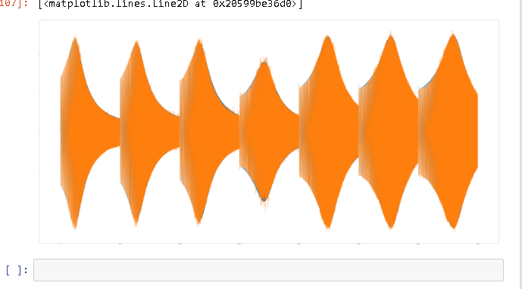
Results
R2 score of 0.956904 is achieved

Slide 8
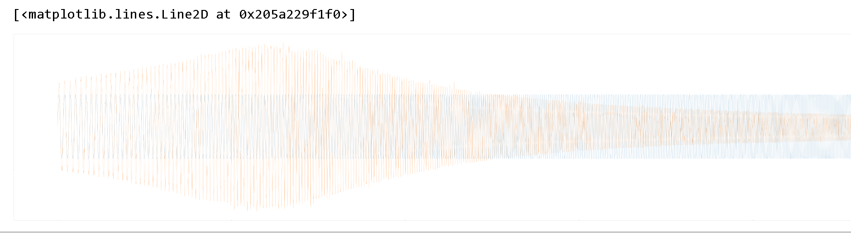
Verification
Predicted response for 0 amps 2.5 v here we can observe that two signals are in phase

Slide 9
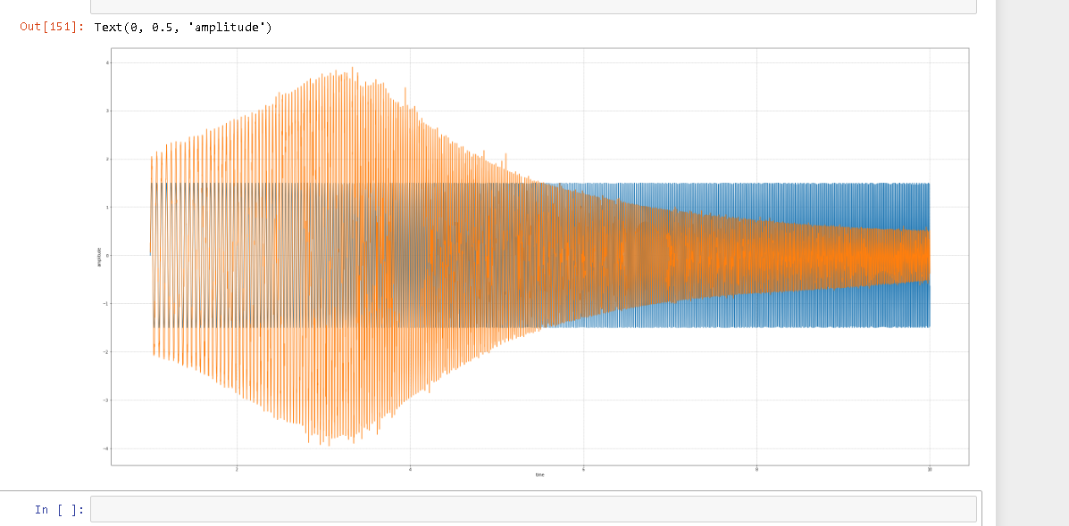
With time axis and amplitude axis to be precise

Slide 10
Conclusion
The model development is successfully
The r2 score obtained from the analysis is 0.956
The verification regarding the phase is also done
The model includes current , voltage , amplitude .
Based on the amplitude the chirp signals are obtained .

Slide 11
References
[1]Chen, S. M., & Billings, S. A. (1989). Neural networks for nonlinear dynamic system modeling and identification. International Journal of Control, 51(6), 1191-1214.
[2]Billings, S. A., & Chen, S. (1991). Representations of nonlinear systems: the NARMAX model. International Journal of Control, 54(6), 1295-1318.
[3]Billings, S. A. (2013). Nonlinear system identification: NARMAX methods in the time, frequency, and spatio-temporal domains. John Wiley & Sons.
[4]Yao, X., & Chen, S. (1996). A novel self-constructing neural fuzzy inference network and its applications. IEEE Transactions on Fuzzy Systems, 4(4), 324-339.

